Slide 1
WEEK 1:
Introduction-to-Digital Circuits
Digital Design Lab. Section (EEE.2003.1)

Slide 2
Aims & Objectives
The Aims:
  Learn about how can be used FPGAs (Field Programmable Gate Arrays) for designed digital circuits
  To learn how to implement reasonably complicated circuits on FPGAs
  To learn how to design with one of the Hardware Description Language (Verilog)
  To provide an understanding of how digital systems communicate with their external enviroment.
By End Of The Lab. Section:
  Understand how A/D and D/A conversion circuits work
  Design some digital circuits on real harware using FPGAs
  Design digital circuits through the use of Verilog HDL, and to write Verilog codes

Slide 3
Design in Real Circuits
  Analogue to Digital (ADC) and Digital to Analogue (DAC) conversion provides the link between the analogue physical world to the digital electronics world
    need to understand HOW analogue signals are converted to digital, and HOW to interpret the datasheet of such components
  Field Programmable Gate Arrays – FPGAs is one of the primary technology for implementing digital circuits nowadays. This has replaced most of the implementations in “discrete logic” (such as 16-pin packaged TTL or CMOS gates). It has also replaced many Application Specific Integrated Circuits (ASICs) that the industry used to design. FPGAs prove to be much lower-risk and must easier to design as compared to other approaches.
  Verilog HDL – using a Hardware Description Language (HDL as it is called), and in our case, using Verilog, is the way that most modern digital systems are specified and designed.
  Laboratory Experiment is EXTREMELY IMPORTANT in helping you to learn this subject. It is intended to teach you how to design digital circuits using Verilog HDL targeting implementations on FPGAs.

Slide 4
DE1-SOC Board
As an example of these laboratory studies is DE1-SoC, an FPGA board. Here is a general block diagram of the board
It consists of a Cyclone V FPGA. It has various input and output devices. This is a very powerful board and it contains lots of additional hardware resources.

Slide 5
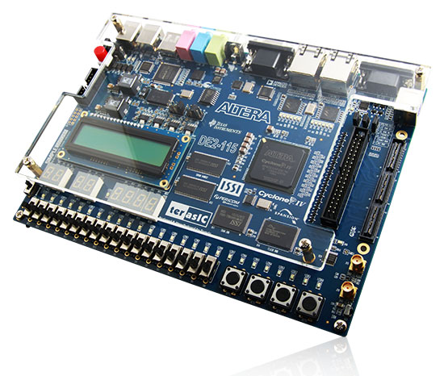
Altera DE2-115 Development & Education Board
DE2-115 that features the Cyclone IV E device.
Responding to increased versatile low-cost spectrum needs driven by the demand for mobile video, voice, data access, and the hunger for high-quality images, the new DE2-115 offers an optimal balance of low cost, low power and a rich supply of logic, memory and DSP capabilities.
The Cyclone EP4CE115 device equipped on the DE2-115 features 114,480 logic elements (LEs), the largest offered in the Cyclone IV E series, up to 3.9-Mbits of RAM, and 266 multipliers.
The DE2-115 adopts similar features from the earlier DE2 series primarily the DE2-70, as well as additional interfaces to support mainstream protocols including Gigabit Ethernet (GbE). A High-Speed Mezzanine Card (HSMC) connector is provided to support additional functionality and connectivity via HSMC daughter cards and cables. For large-scale ASIC prototype development, a connection can be made with two or more FPGA-based boards by means of a HSMC cable through the HSMC connector.

Slide 6
Lecture Plan
Introduction & Verilog
  Introduction to Digital Logic
  Introduction to FPGAs
  Verilog HDL
Control Logic Design and timing
  Counters/Timers & Shift Registers
  Finite state machine
Interfacing to analogue circuits
  A-to-D converters
Digital systems and interfaces
  Parallel Interface
Memory Circuits
  Memory interface and embedded memory
  External memory, SRAMs and SDRAMs
Computation circuits
  Arithmetic circuits in FPGAs
  Processors on FPGA
  A simple microprocessor will be designed using FPGA

Slide 7

Digital Design
Logic Levels:
  A logic 1 (or high) is usually represented by the positive supply voltage (e.g. 3.3v)
  A digital chip can have multiple positive supply voltages
    For example, FPGA internal circuits may use 1.8v, but interface circuits use 3.3v
  A logic 0 (or low) is usually GND or 0V
Gates:
  The label indicates how many of the inputs must be high to make the output high:
    & AND gate: all inputs high
    ≥1 OR gate: one or more inputs high
    =1 Exclusive-OR: exactly one input high
    2n Even Parity: even number of inputs high
Inversion triangles (or bubbles):
  Instead of using curves for gates, one could use rectangular blocks and a symbol to denote the logic function.
  Inversion could be on the input or output terminal.
  Instead of a circle, we could use a small triangle as shown here.

Slide 8
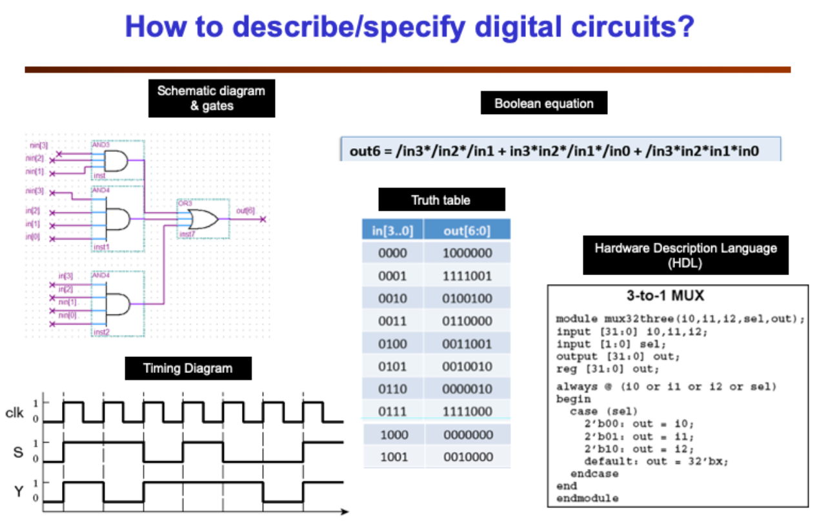
How to describe/specify digital circuits?
[I]
Boolean equations – provides a formal way to express logical relationships between Boolean variables. Useful when designing on paper, but less useful in practice.
Truth Tables – universal way to describe the behaviour of a circuit
Timing diagrams – useful way to explain behaviour of sequential circuits
Hardware Description Languages (HDLs) – using Verilog HDL, which is one that is very closed to the C language. It is also used extensively for designing integrated circuits such as ASICs and other type of chips. Another popular HDL is VHDL.

Slide 9
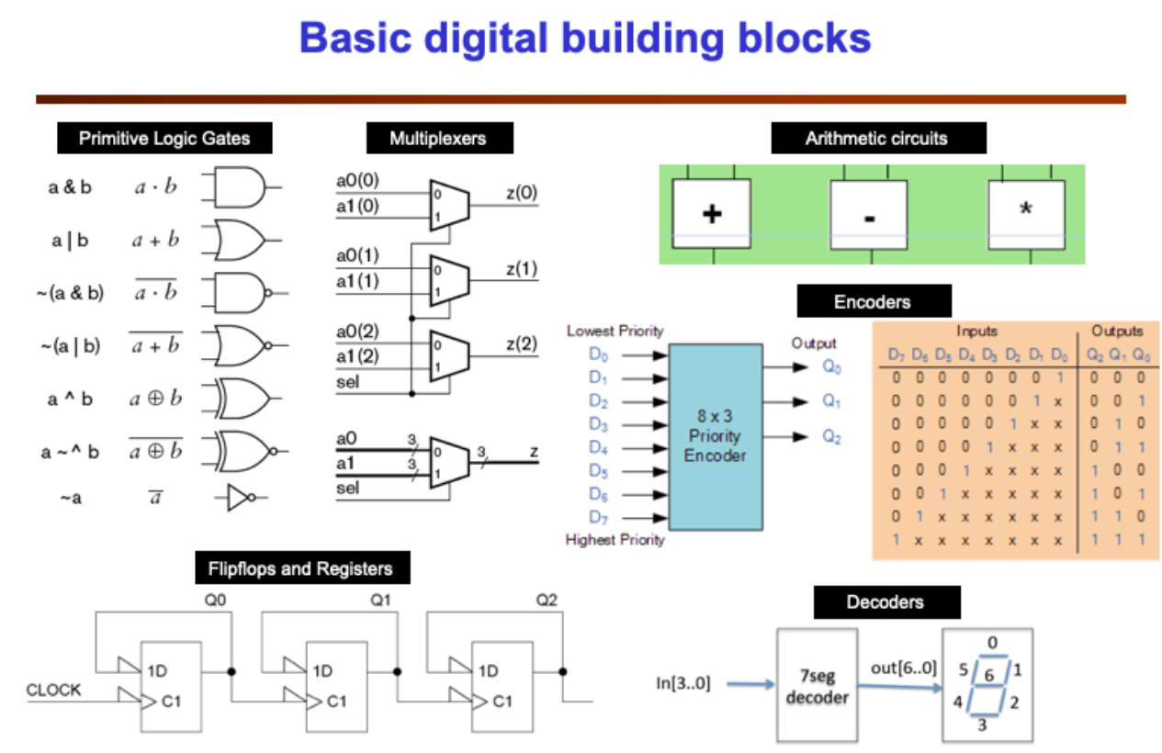
How to describe/specify digital circuits?
[II]
Primitive gates – We have the basic AND, OR, NAND, NOR, XOR and XNOR gates:
Multiplexers MUXs – Shown here is a 2-to-1 MUX with 2 data inputs and 1 select input. The output is 1 or depending on the select input (sel):
  Often put a number of together to provide multiplexing function to a mult-bit data word (as shown here with two 3-bit numbers)

Slide 10
How to describe/specify digital circuits?
[III]
Arithmetic circuits – Commonly found are adders and multipliers. Subtractor can be built from an adder if we use 2’s complement representation of signed integers.
Encoders/Decoders –Encoding is a logic module that reduces (encodes) a large number of bits and produces fewer output bits.
  The encoder here is known as a priority encoder. It produces a 3-bit output showing where the first ‘1’ is encounters from the most-significant bit D7 to the least significant bit D0.
Decoders are the opposite.
  Shown here is a 7-segment display decoder, where 4 input bits are decoded into 7 logic output signals to drive the 7-segments of the display.

Slide 11
How to describe/specify digital circuits?
[IV]
Flipflops and Registers – These are the building blocks for all sequential circuits.
However, nowadays, we rarely design large digital systems at such low levels.
Instead we generally try to express these building blocks in a more abstract manner in a hardware description language.
In addition to these basic blocks, we also have memory devices and microprocessors.

Slide 12
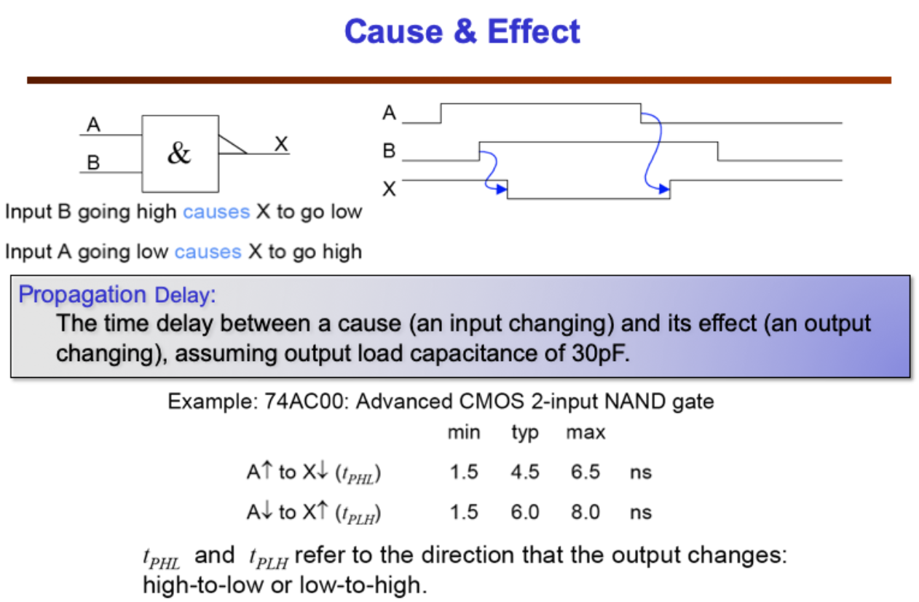
How to describe/specify digital circuits?
[V]
All digital circuits exhibit propagation delay.
  Here it shows the delay table for a “discrete logic” CMOS NAND gate:
  The delay could be in the region of nanoseconds.
  As can be seen later, the “gate” inside the FPGA is also much more complex than a simple NAND gate.
Also note that propagation delay depends on the “cause” (input rising or falling, and on the slope of the edge) and the “effect” (output rising or falling). Delay also depends on what are connected to the output (i.e. the loading).

Slide 13
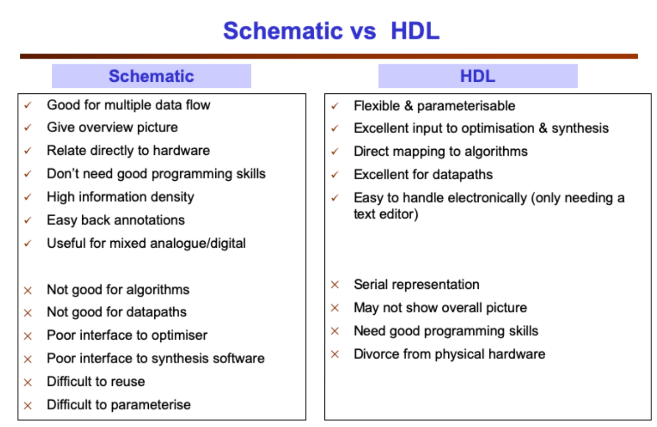
Verilog HDL
[I]
Verilog HDL, which, together with another language VHDL, are the most popular hardware languages used in industry.
By the end of lab section, you should understand:
  Why Hardware Description Language (HDL) is a better design entry method than schematic entry?
  The basic structure/Syntax/Variables of a module specified in Verilog HDL

Slide 14
Verilog HDL
[II]
You are very familiar with schematic capture. However modern digital design methods in general DO NOT use schematics. Specify the design requirement or the algorithm to be implemented in “Hardware Description Languages” (HDLs).
The most important advantages of HDL as a means of specifying your digital design are:
  You can make the design take on parameters (such as number of bits in an adder)
  it is much easier to use compilation and synthesis tools with a text file than with schematic, and you can easily edit, store and transmit a text file, and much hardware with a schematic diagram.
  it is very difficult to express an algorithm in diagram form, but it is very easy with a computer language. You can use various datapath operators such as +, * etc.

Slide 15
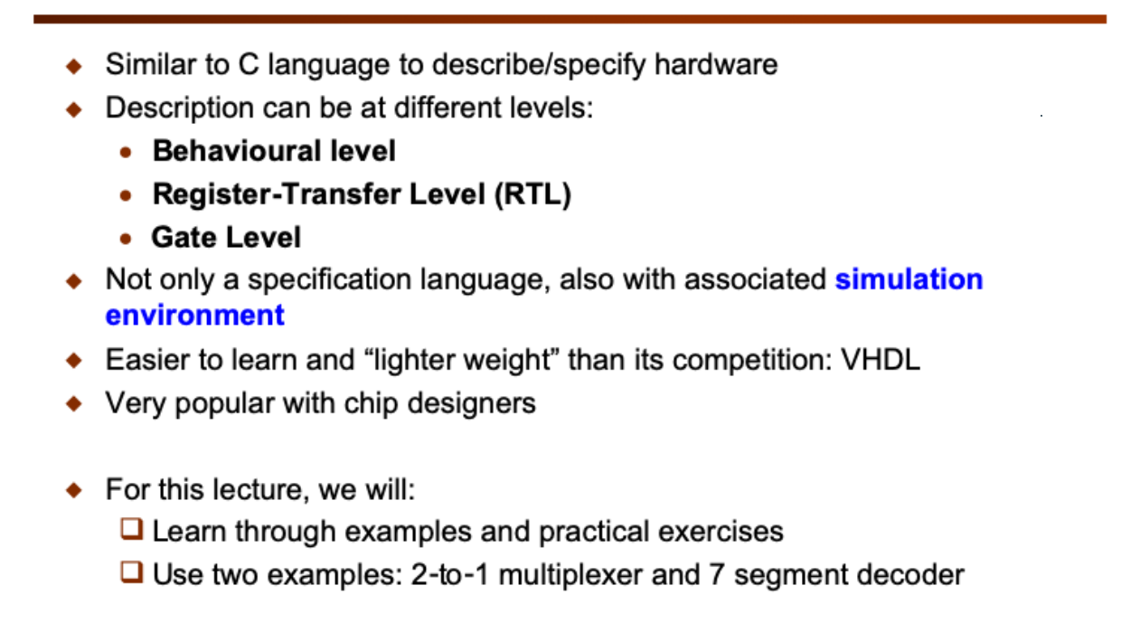
Verilog HDL
[III]
You can use Verilog to describe your digital hardware in 3 different level of abstraction:
  Behavioural Level – you only describe how the hardware should behave without ANY reference to digital hardware.
  Register-Transfer-Level (RTL) – Here the description assumes the existence of registers and these are clocked by a clock signal. Therefore digital data is transferred from one register to the next on successive clock cycles. Timing (in terms of clock cycles) is therefore explicitly defined in the Verilog code.
  Gate Level – this is the lowest level description where each gate and its interconnection are explicitly specified.
Verilog is a specification language which tells the CAD system what hardware is suppose to do, it also includes a complete simulation environment. A Verilog compiler does more than mapping your code to hardware, it also can simulate (or execute) your design to predict the behaviour of your circuit.

Slide 16
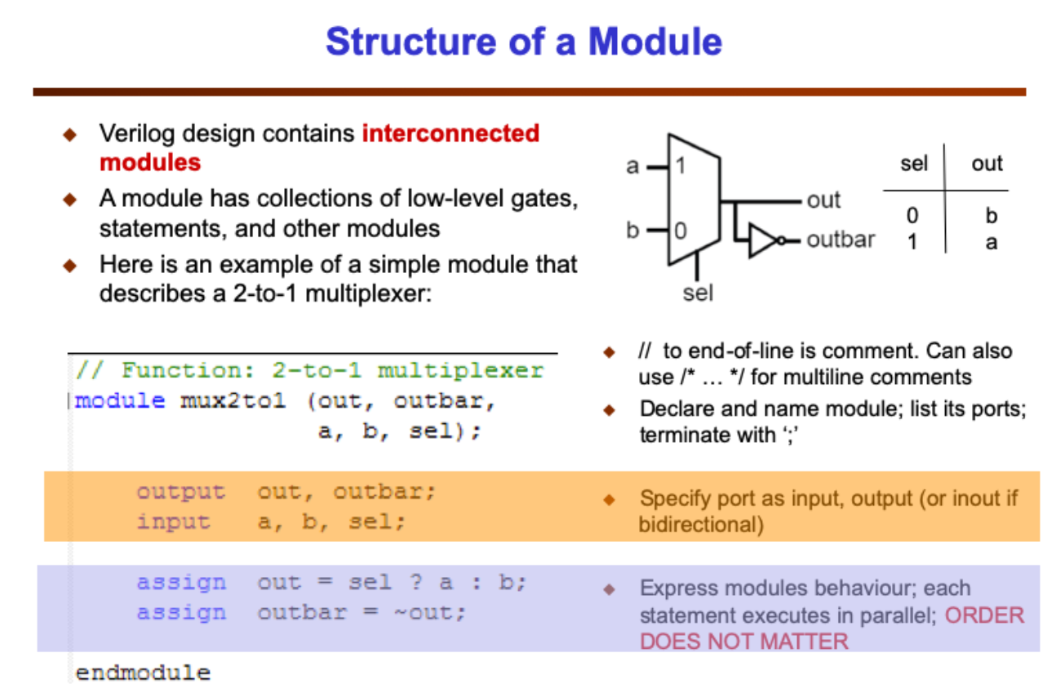
Verilog HDL
[IV]
This is a Verilog module that specifies a 2-to-1 multiplexer. It is rather similar to a C function (except for the module keyword): module name: mux2to1
A list of interface ports:
  3 inputs a, b and sel
  2 outputs out and outbar
2-to-1 multiplexing function is specified in the assign statement with a construct that is found in C. This is a behavioural description of the multiplexer – no gates are involved.

Slide 17
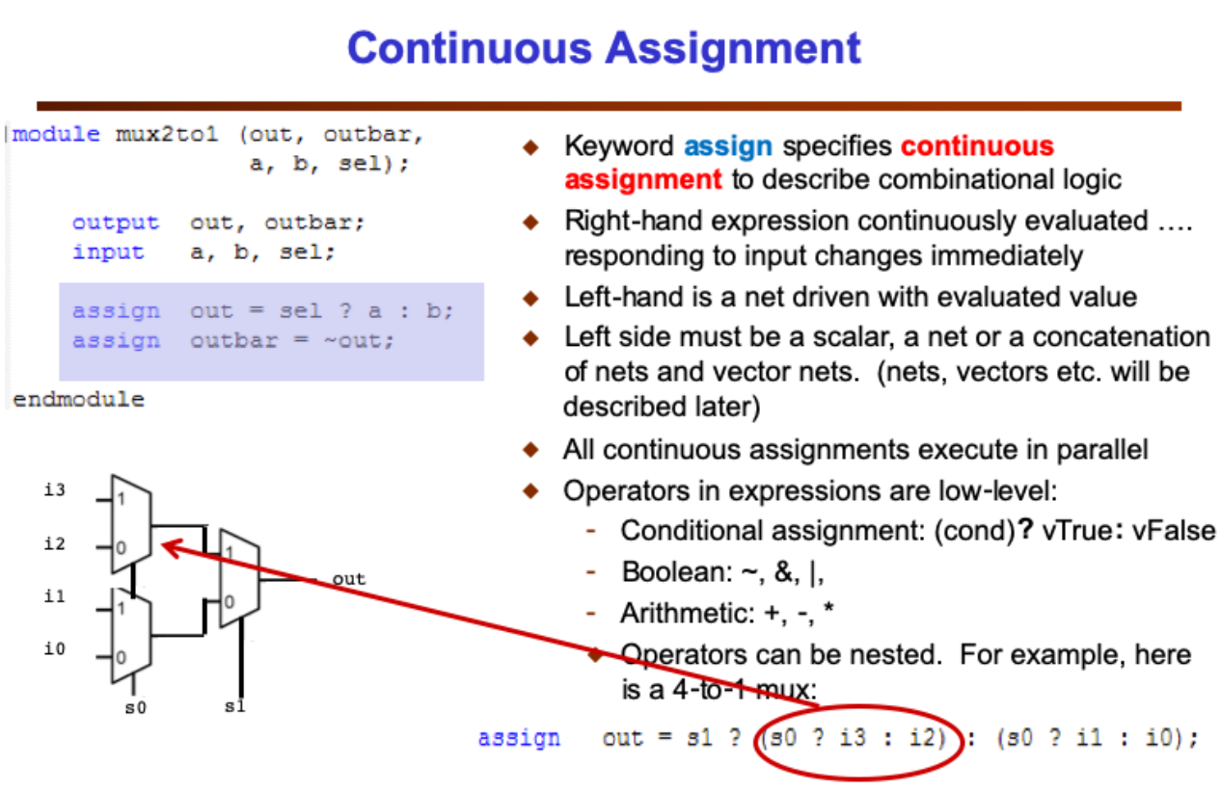
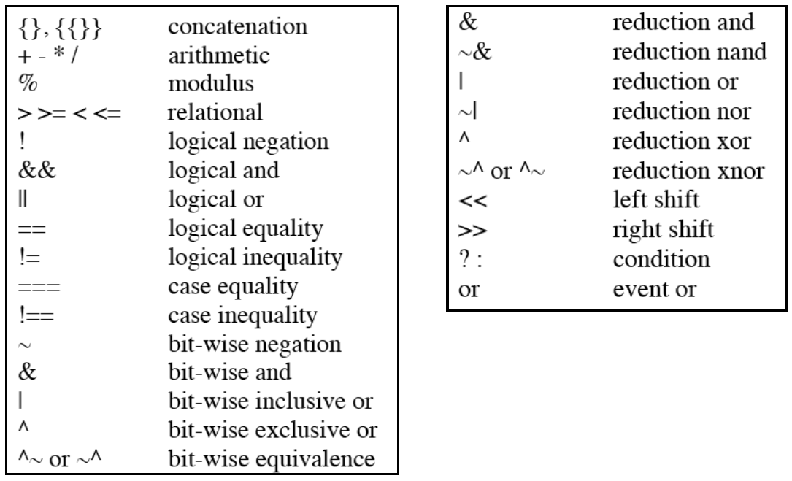
Verilog HDL
[V]
Continuous assignment specifies combinational circuits – output is continuously reflecting the operations applied to the input, just like hardware.
there are many other Boolean and arithmetic operators defined in Verilog (as in C). Here is a quick summary of all the Verilog operators:

Slide 18
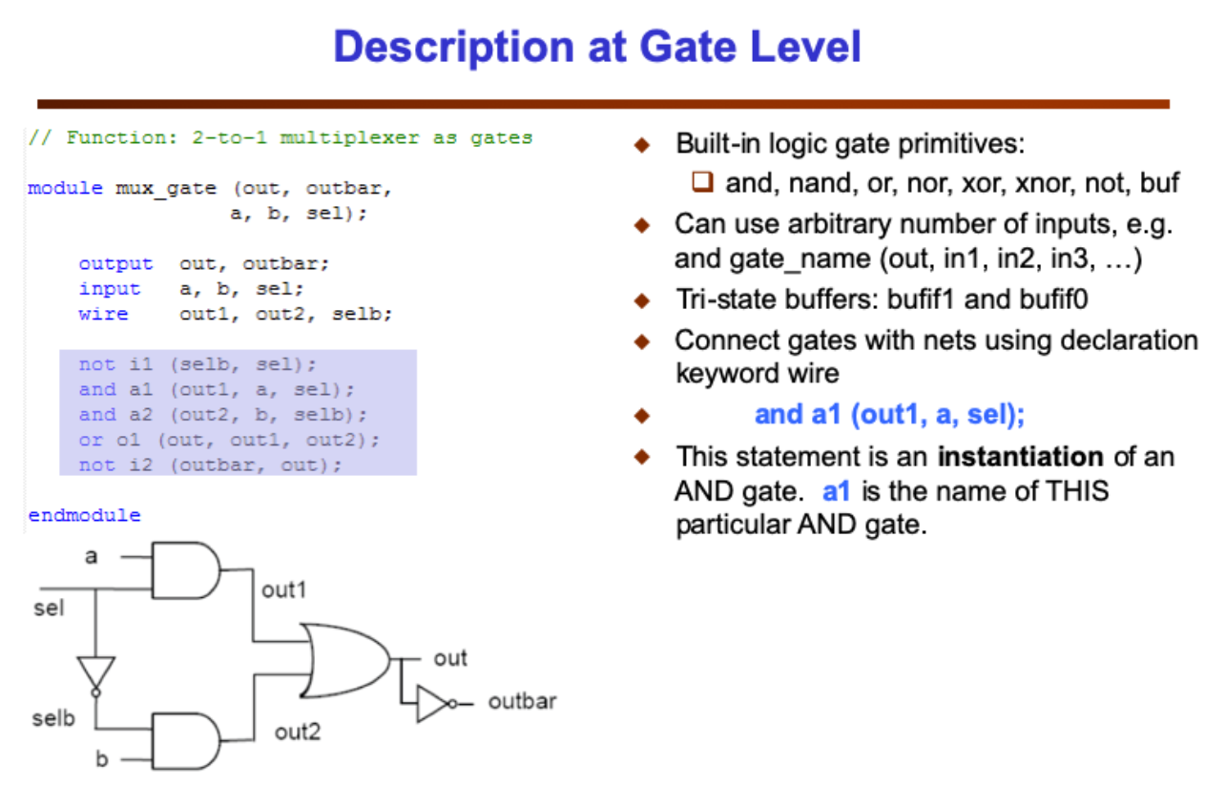
Verilog HDL
[V]
Three types of gates are used: and, or and not gates. There are internal nets (declared as wire) which must also be declared and are used to connect gates together.
Keywords such as and, or and xor are special – they specify actual logic gates. They are also special in that the number of inputs to the and-gate can be 2, 3, 4, ….. Any length!
Module uses 2 AND gates, and they have different names: a1 and a2.
  Here the two statements “and a1 (out1, …” and “and a2 (out2 …” produce 2 separate piece of hardware. We say that each line is “instantiating” an AND gate.

